Slide 1
Map The List
by Francisco Valle

Slide 2
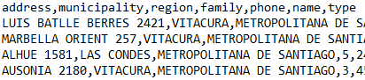
Problem and Context
.csv Database
List of addresses with no gps coordinate:
Database format: .CSV
Need of a first view of the data in a map
Solution
Program output:
Database with the gps coordinates and google name of the addresses.
Google Map will show specific information of each pin

Slide 3

First Process View
Select File & generate
gps address
Map or not
Mapping
Iteration or End
Process: User selects a Database to work on, and the gps of each row is added to the database.
Tools: Use
Process: User decides if the map is needed.
Program ends if map is not needed.
Tools: Python basics of user input/output and boolean variables.
Process: Each gps address is added to the map.
Tools:Google Maps API Javascript
Process: Program asks if another database is needed to work on or not.
Tools:Python basics of user input/output and boolean variables.

Slide 4
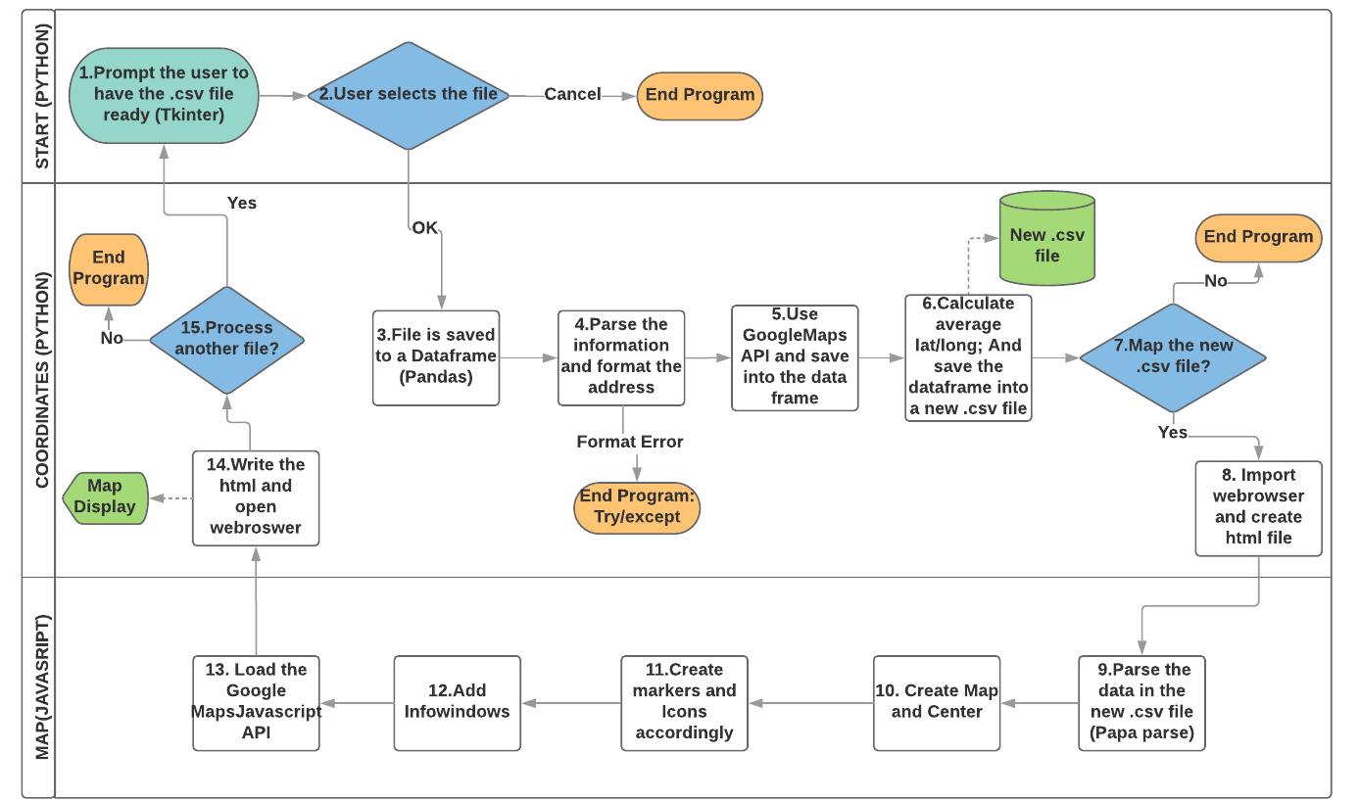

Slide 5

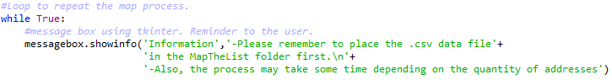
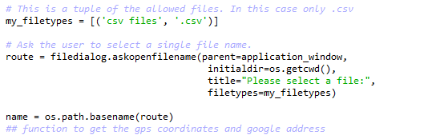
The Code (Python)
1.Prompt the user to have the file ready
2.User selects .csv files

Slide 7
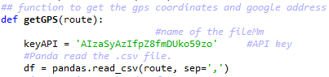
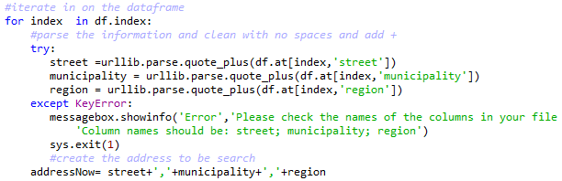
The Code (Python)
3. Function getGPS. Save .csv file to a dataframe
4.Function getGPS. Parse information and format data

Slide 9
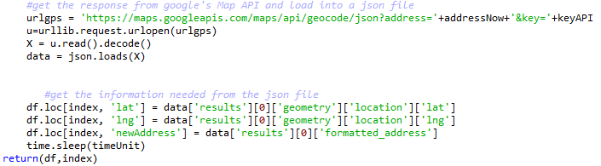
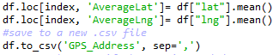
The Code (Python)
5. Function getGPS. Use GoogleMaps API and save to dataframe
6. Calculate average and save the dataframe into a new .csv file

Slide 11
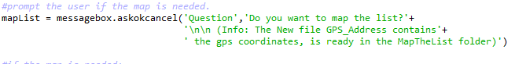
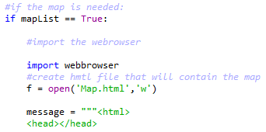
The Code (Python)
7. Map the new file?
8.Import webbrowser and create the .html file

Slide 13
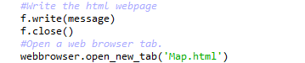
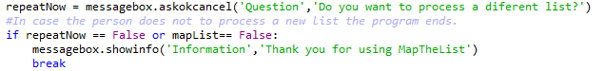
The Code (Python)
14.Write the html and open the web browser
15.Process another list?

Slide 14

The Code
Main Python packages used:
Pandas
Json
Urllib.parse and urllib.request
Tkinter
Main JavaScript packages used:
Papa Parse

Slide 15
LIVE DEMO

Slide 16
Difficulties and Lessons
Many changes needed while working:
Lesson: Clarify the scope and exact input and output.
The first solution is not always the best:
Lesson: Read a couple of solution before applying.
The program crashed many times:
Lesson: Always save older versions.
Lesson: Test regularly.

Slide 17
Map The List

Slide 18
Annex Javascript Code

Slide 19
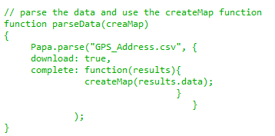
The Code (JavaScript)
9.Function parseData. Parse the data of the new .csv file

Slide 20
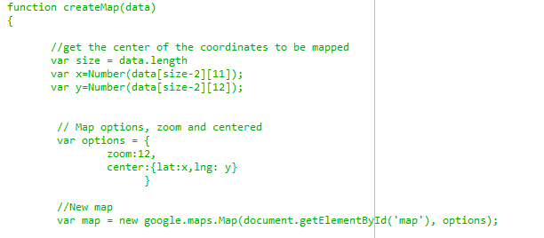
The Code (JavaScript)
10. Function createMap. Creates the map and center

Slide 21
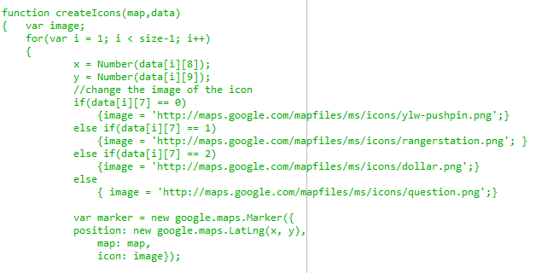
The Code (JavaScript)
11.Function createIcons. Create the markers and icons

Slide 22
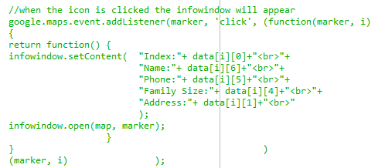
The Code (JavaScript)
12.Create infowindows for each marker

Slide 23
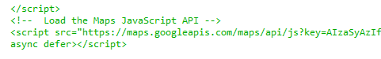
The Code (JavaScript)
13.Load Google Maps JavaScript API

